Slide 1
Olympic Odysseys: The Impact of the "Golden Goal" On The Price Of Hockey Cards
Jude Yurcich

Slide 2
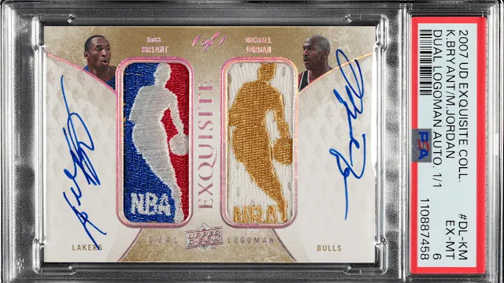
Introduction
Sports card market: Famous for being speculative and high-value
Highest priced card: $12.9 million for joint Bryant/Jordan card
2026 Winter Olympics caused Jack Hughes’ stock to rise immensely, including Young Guns cards

Slide 3
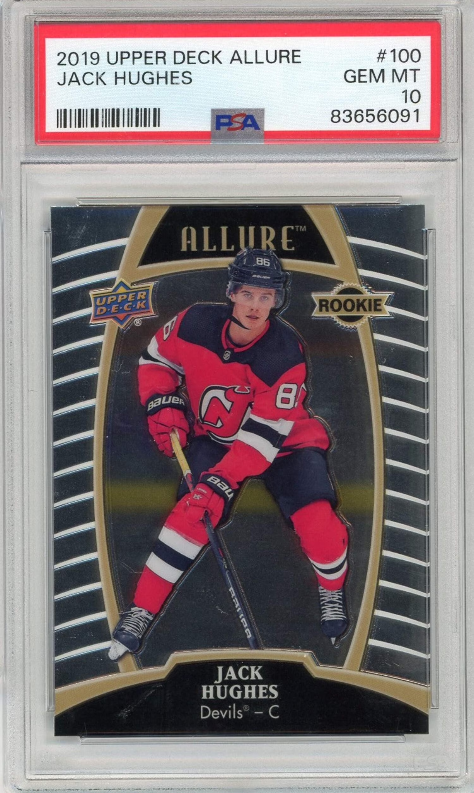
Research Question
Did the 2026 Winter Olympics results cause Jack Hughes' graded rookie cards to rise in value?

Slide 4

Data Collection
I used SerpApi’s eBay search API to collect my data
Documentation was fairly straightforward as it was all explained on SerpApi’s website (for example, “buying_format” and “engine” were self-explanatory and easy to use)
To understand, I immersed myself in the website, reading all the necessary information to get where I needed to go

Slide 5
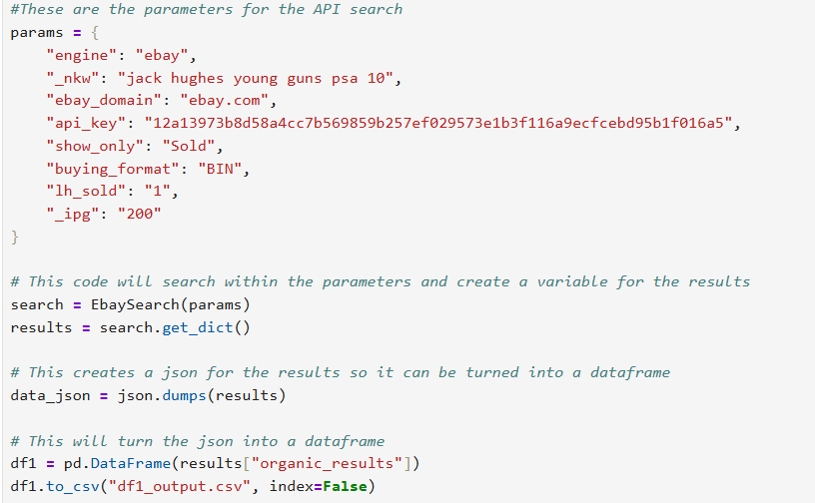
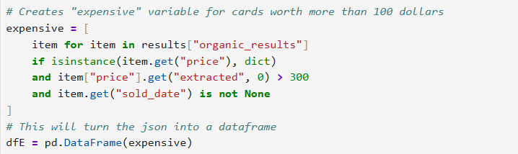
Data Collection Parameters

Slide 6

Variables
I had several variables for my project
In my regression, I used the Price, Shipping, Sold After 2/22/26 dummy, and rating variables (rating had no effect)
These were all collected and cleaned via eBay’s API and Python

Slide 7
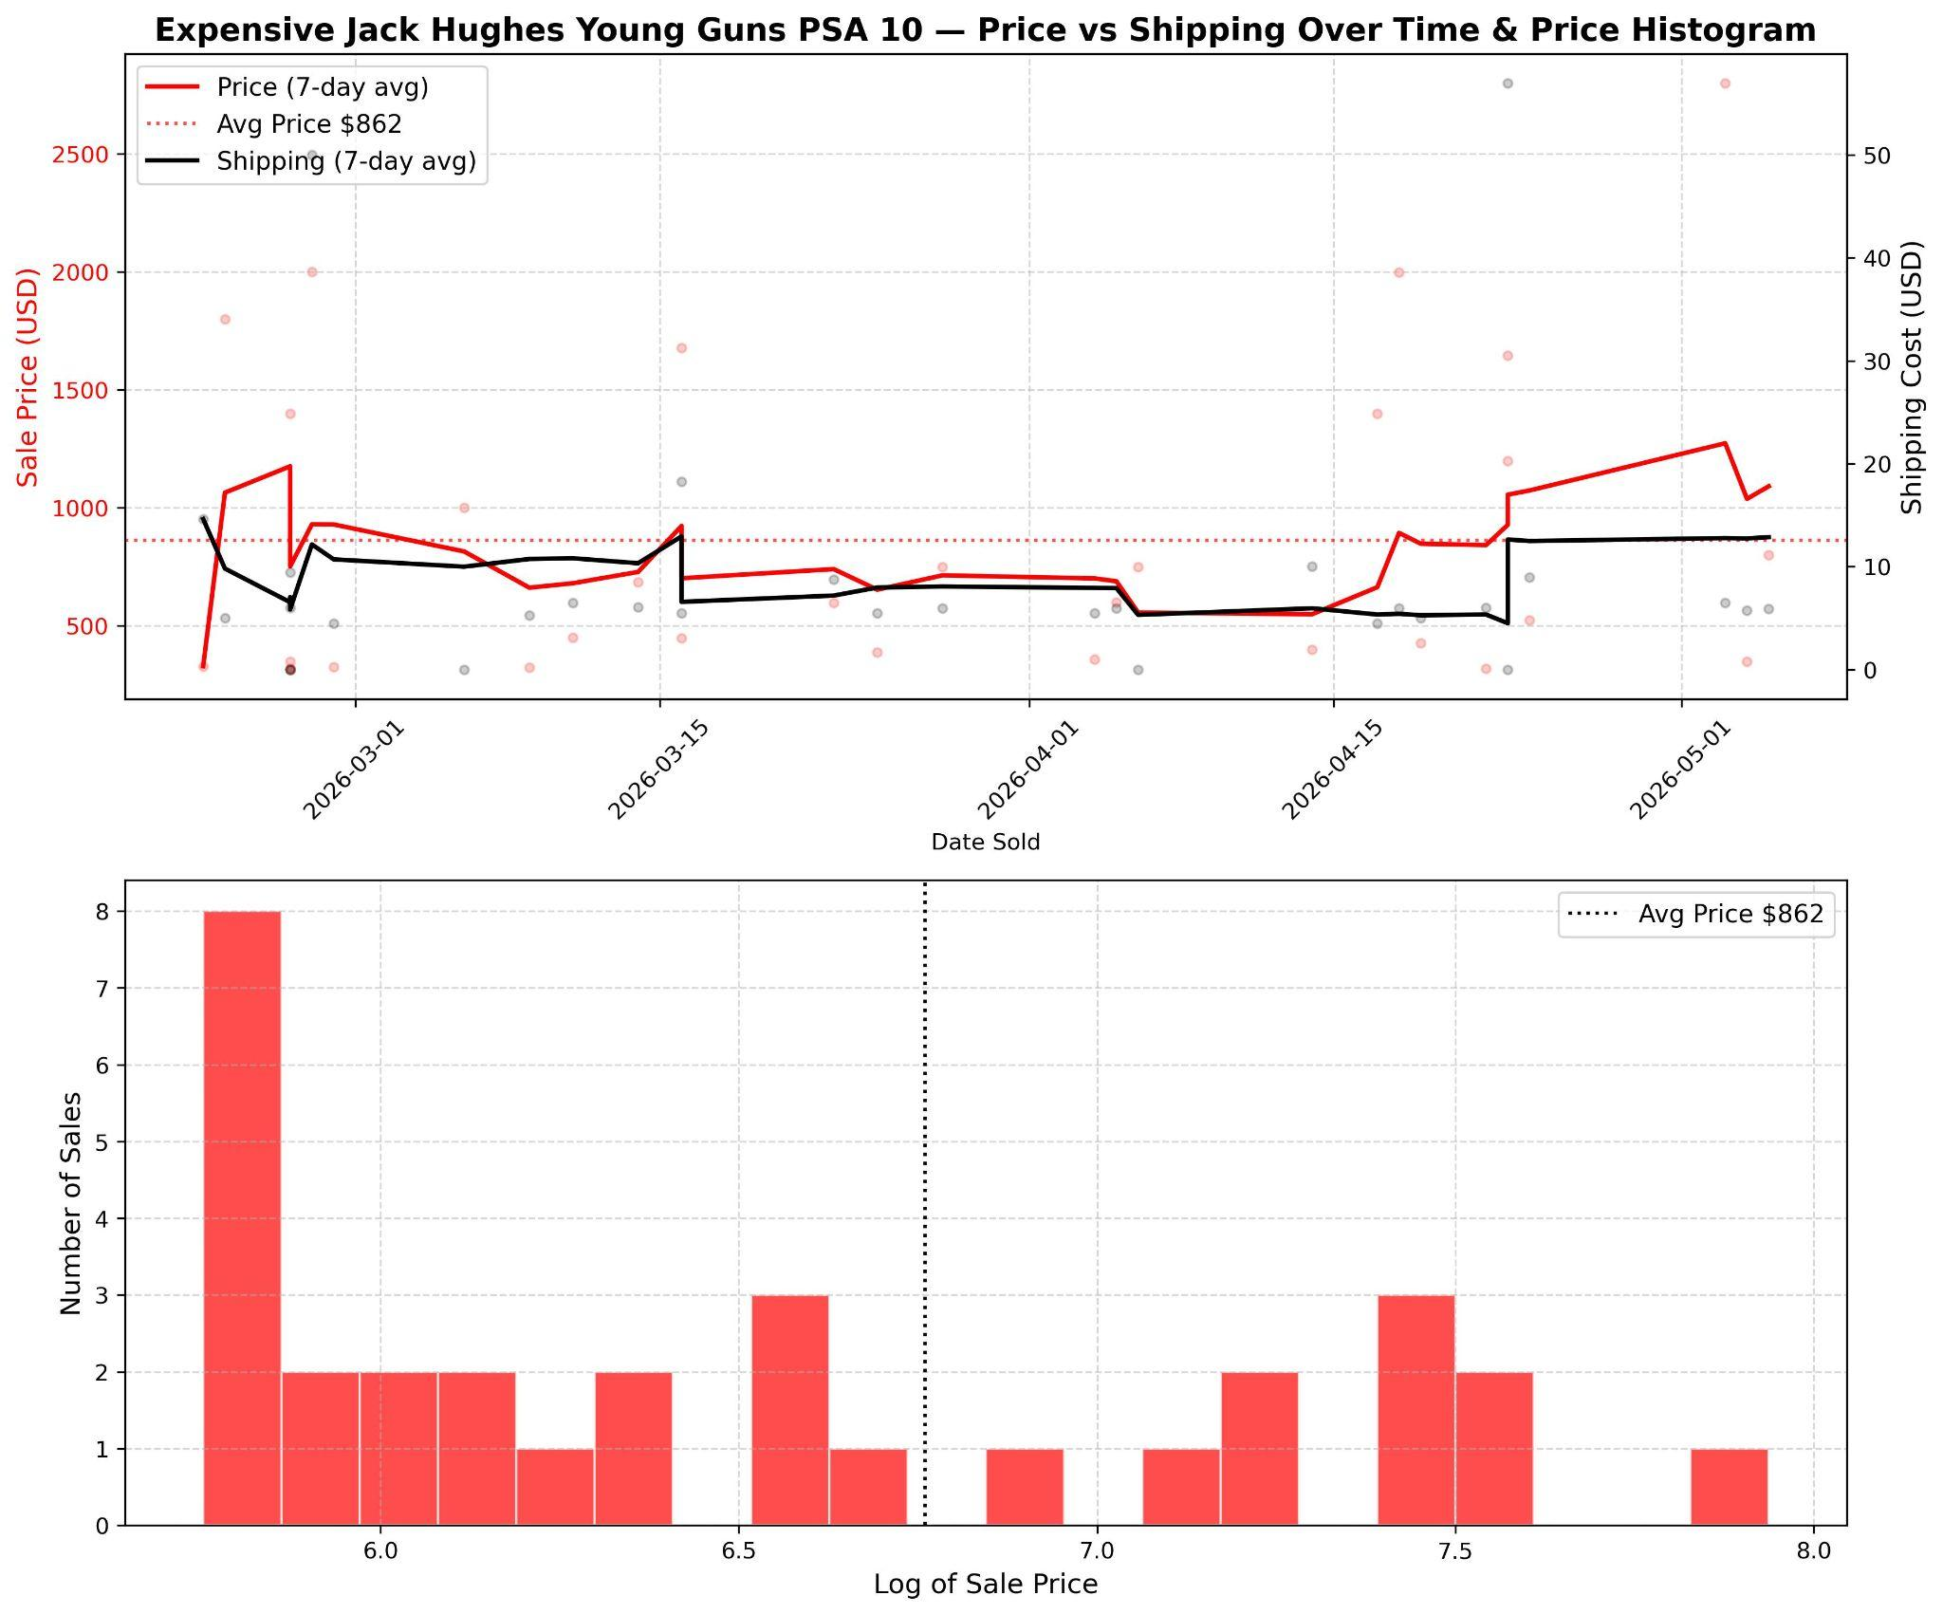
Graphs

Slide 8
Regression Equations
OLS: logofprice_{it}= β₀+ β₁after2/22/26 + β₂rating + β₃logofshipping + β₄usseller + ∊
Filtered OLS: OLS: OLS: logofexpensivecardprice_{it}= β₀+ β₁logofshipping + β₂rating + β₃usseller + ∊
Polynomial: OLS: logofprice_{it}= β₀+ β₁logofshipping² + β₂rating + β₃after2/22/26 + β₄usseller + ∊

Slide 9
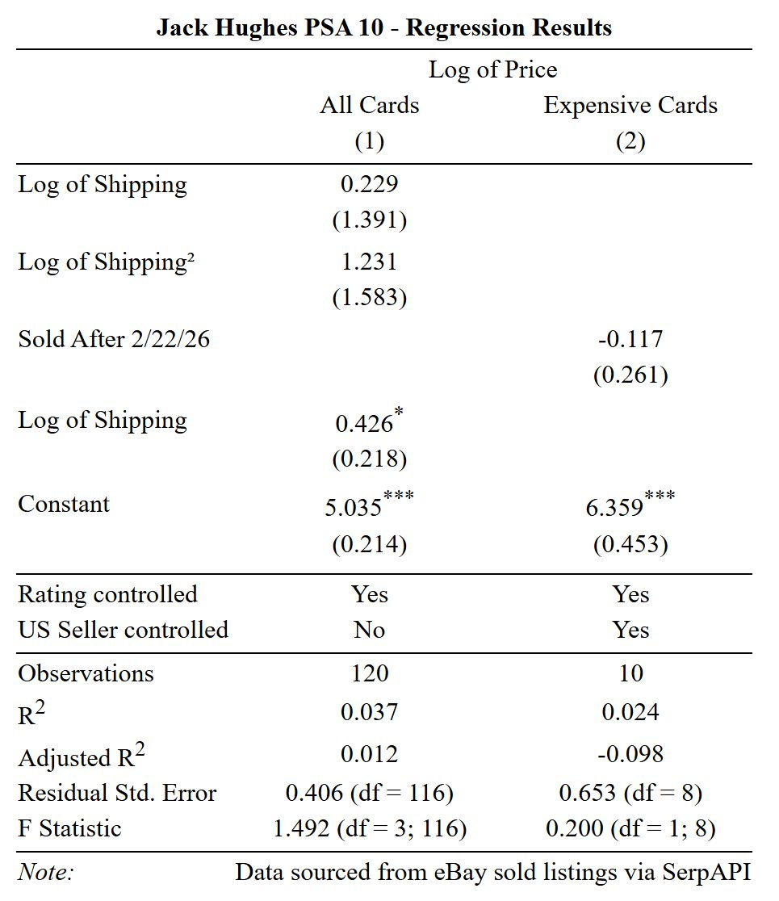
Regressions

